Slide 1
Forecasting Global Warming and its Effects

Slide 2
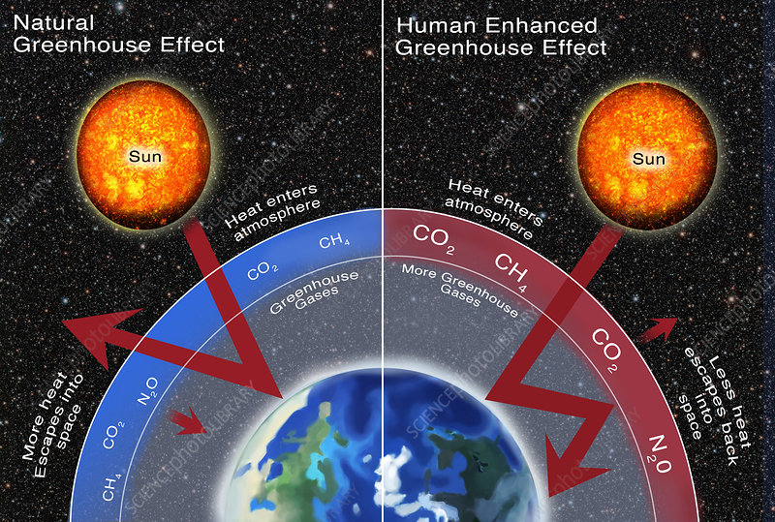
Purpose
Overwhelming scientific consensus, yet skepticism in general public.
Greenhouse Gas Effect
Critical tipping points and Hothouse Climate State

Slide 3
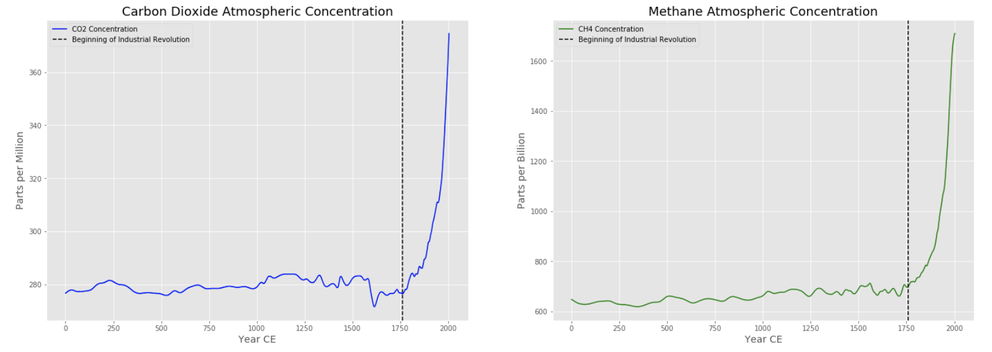
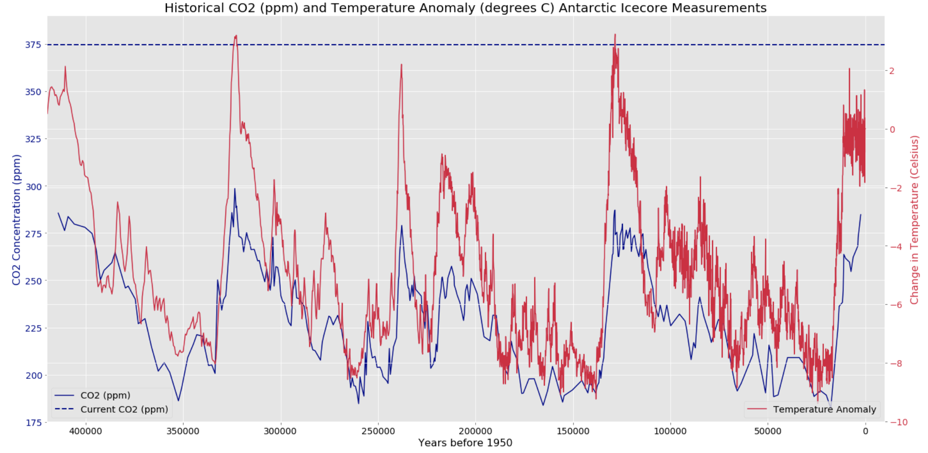
Critical Tipping Points
Temperature Anomaly: +2.0 C
Atmospheric CO₂ Conc.: 450 ppm

Slide 4
Methodology
Climate Change Aspect | Model Type | Accuracy
Global Temperature Anomaly | SARIMA | 74.6%
Sea Ice Extent (N. Hemisphere) | SARIMA | 97.5%
Sea Ice Extent (S. Hemisphere) | SARIMA | 98.2%
Sea Level | SARIMA | 93.6%
Atmospheric CO₂ Conc. | Holt | 94.5%
Atmospheric CH₄ Conc. | Holt | 95.8%
Various data sources (NASA, EPA, NOAA, etc.)
Granger Causality Test
Model and forecast

Slide 5
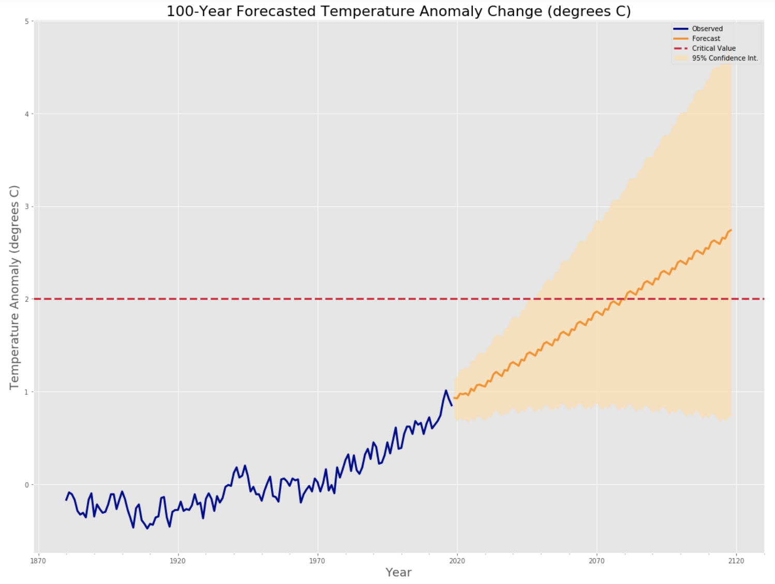
Global Average Temperature Anomaly
Critical value: +2.0 C
Rate of increase: 0.0256 C per year
Projected to reach critical value in 2081

Slide 6
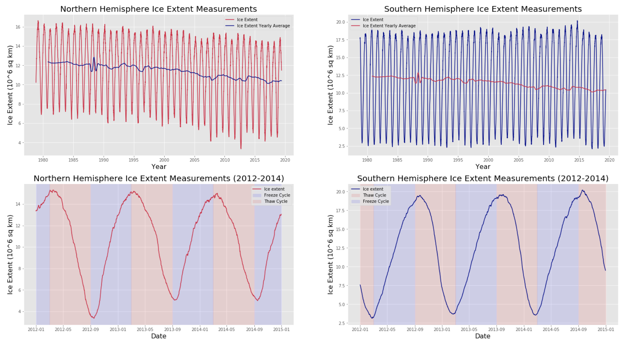
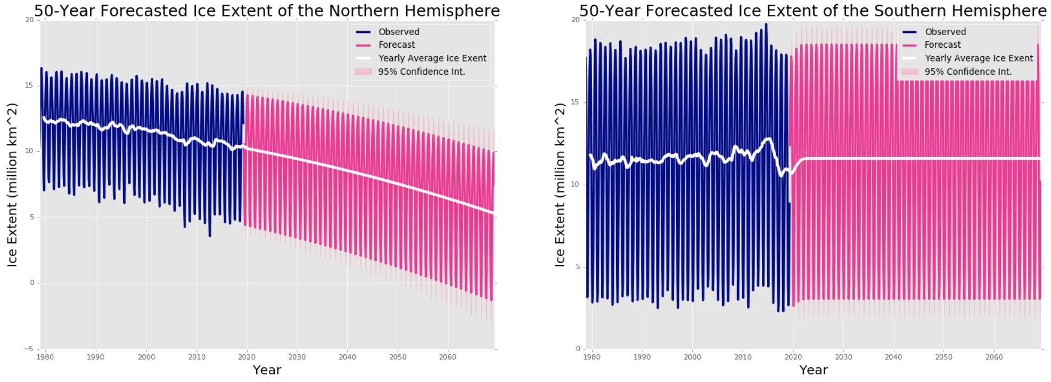
Sea Ice Extent
Reflects 50% - 70% solar radiation
Rises in global temperature anomaly granger-cause decreases in sea ice extent
Loss of 4.383 million km² over 40 years

Slide 7
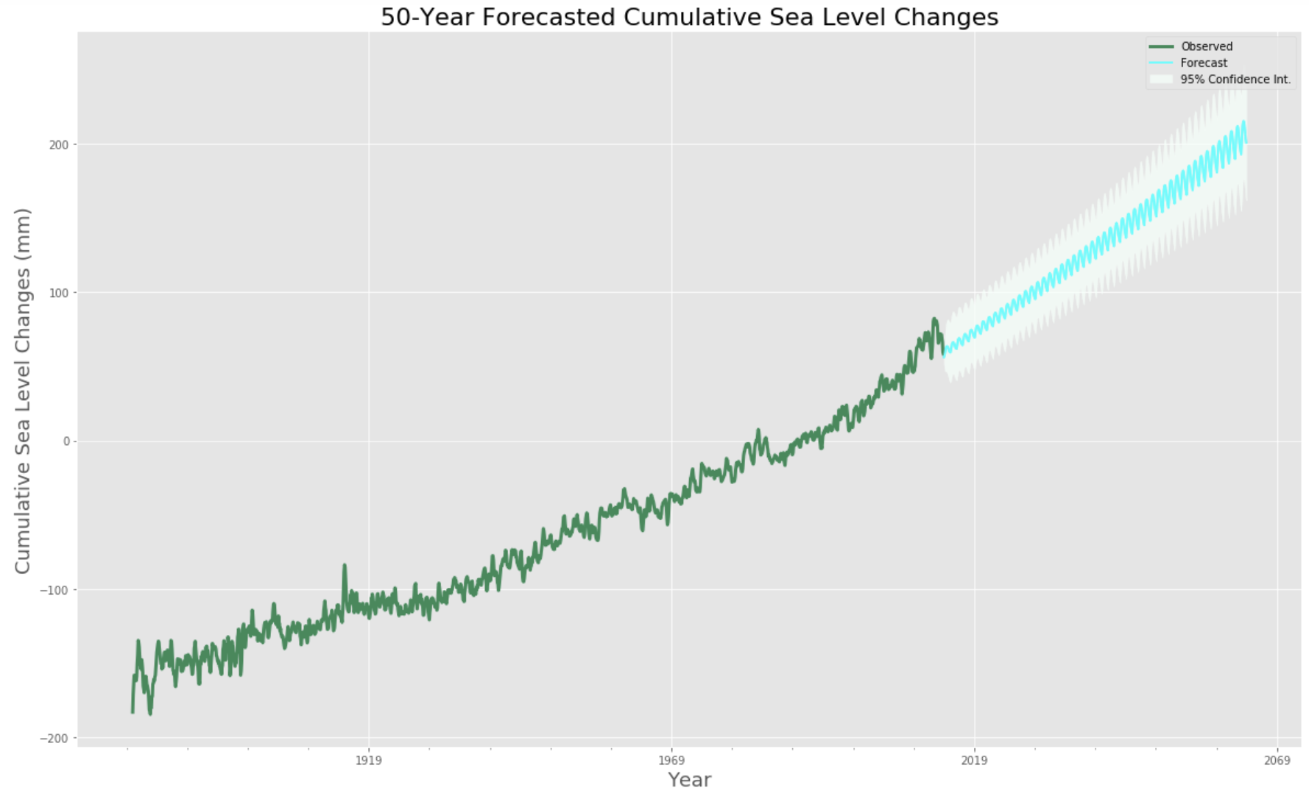
Rising Sea Levels
Archimedes Principle
GRANGER RESULTS
RATE OF INCREASE
Immediate threat to agricultural, residential, and commercial infrastructure in coastal regions

Slide 8
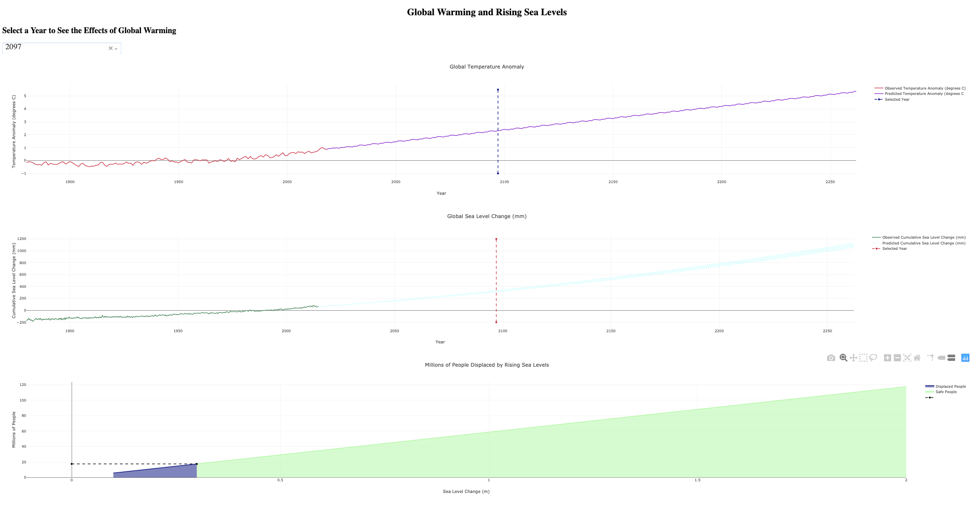
Estimating Human Cost of Rising Sea Levels
2010 Population estimates
0.1m rise by 4/2029 → 5.9 million people
0.5m rise by 5/2141 → 29.4 million people
1m rise by 6/2239 → 58.8 million people

Slide 9
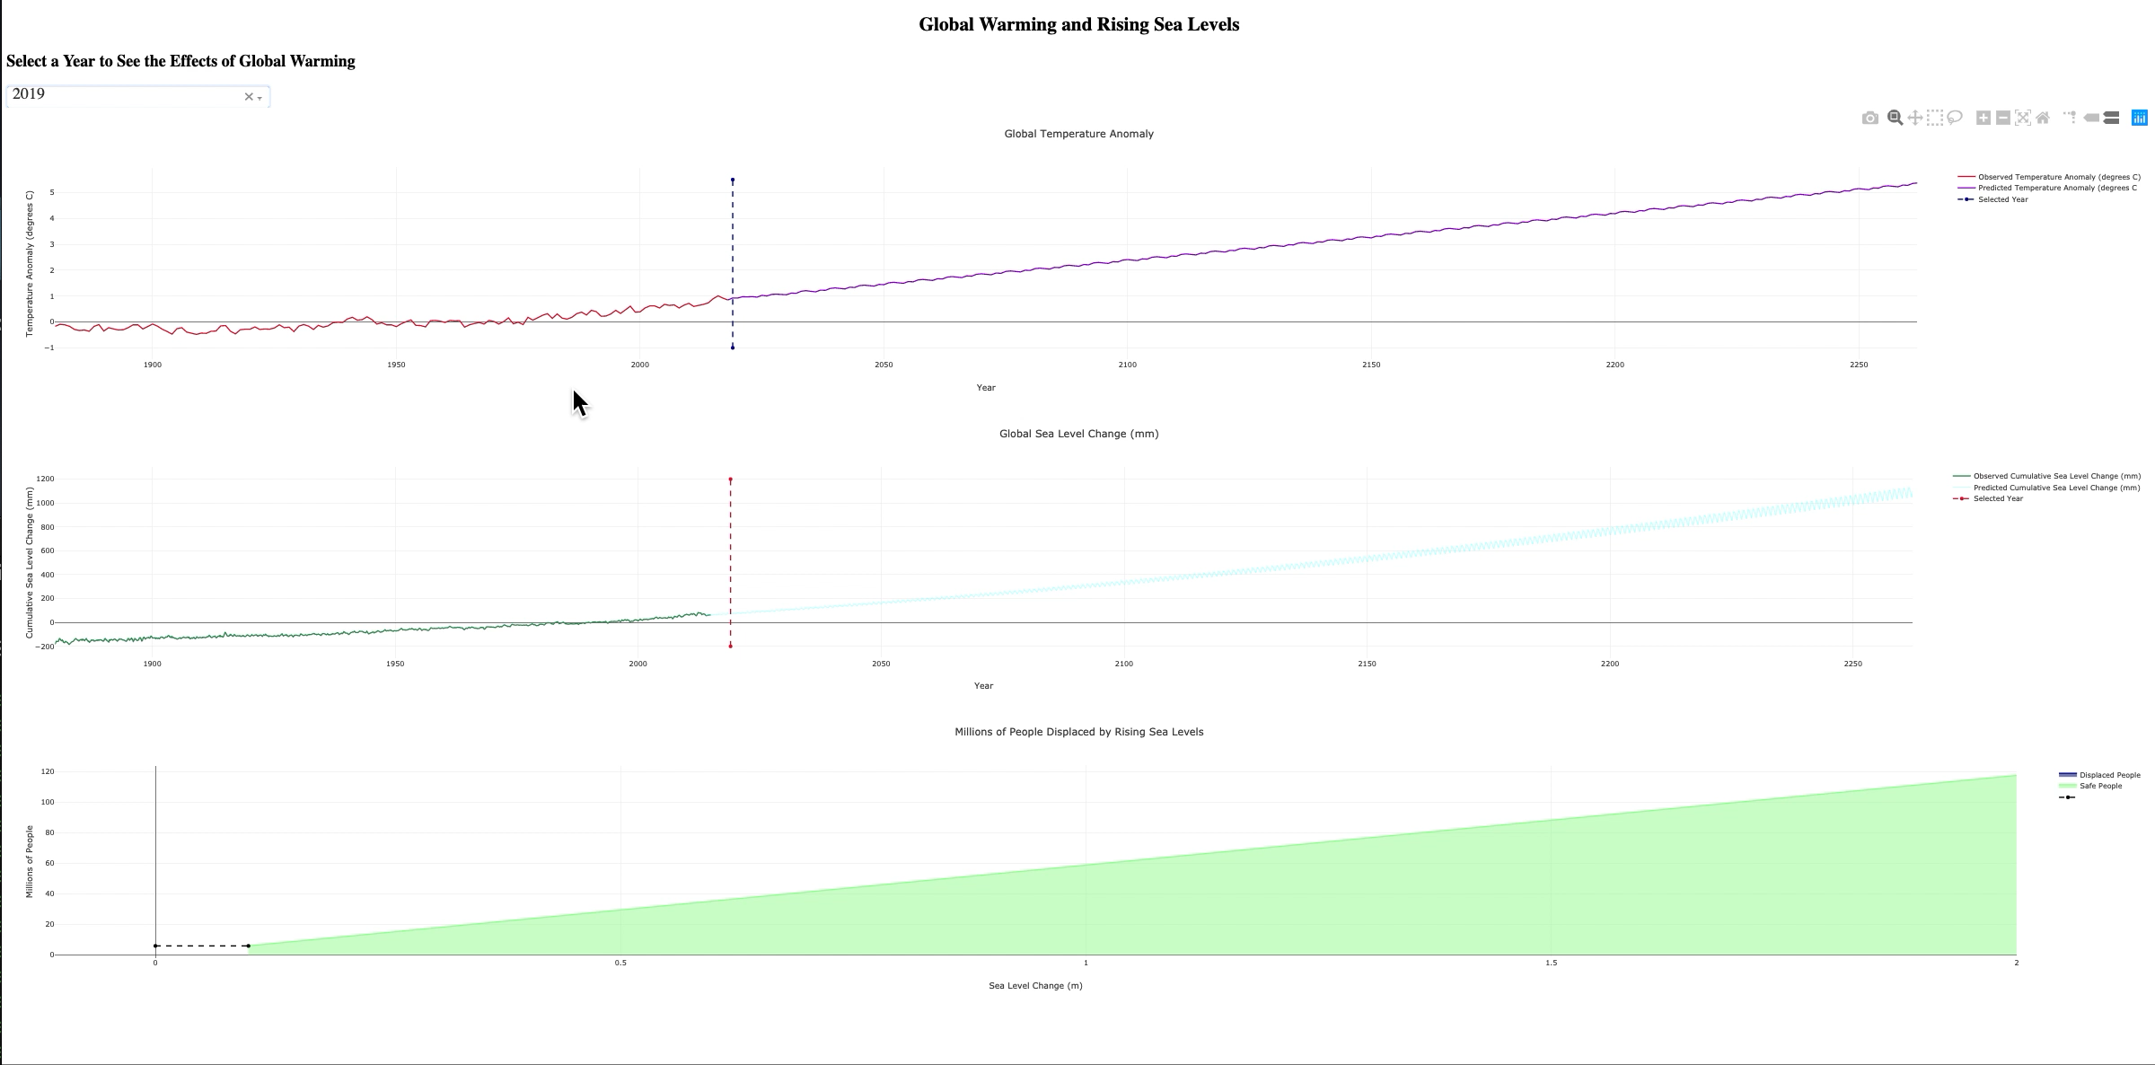
Recommendations
Increase public awareness
Describe impact to humanity
Reduce Greenhouse Gases

Slide 10
Future Work
Integrate data to improve model performance
Model greenhouse gases to estimate performance of mitigation efforts
Create applications to spread awareness of additional aspects of climate change

Slide 11
Thank You
Questions?

